Slide 1

ADVANCED MARKET RESEARCH & ANALYTICS
Tanmoy Chandra
C23036
Angshuman Pandey
C23005
Dipam Sarkar C23010

Slide 2


Agenda
Psychographic statement
Identifying characteristics of clusters
Cluster wise analyzing demographics and product ownership Identifying cluster membership
Brand Recommendation

Slide 3
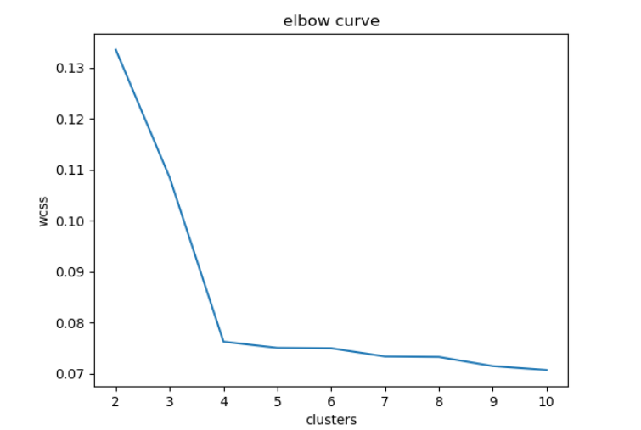
Cluster Analysis
After analyzing the available numeric features, we performed clustering using the k-means algorithm. The elbow curve revealed that the ideal number of clusters is 4, as the within-cluster sum of squared errors decreases significantly at this point. To address the centroid initialization problem, we employed the k-means++ method. This allows us to confidently use 4 clusters as the optimal number for our data segmentation, enabling better insights and decision-making based on the distinct customer segments.

Slide 4

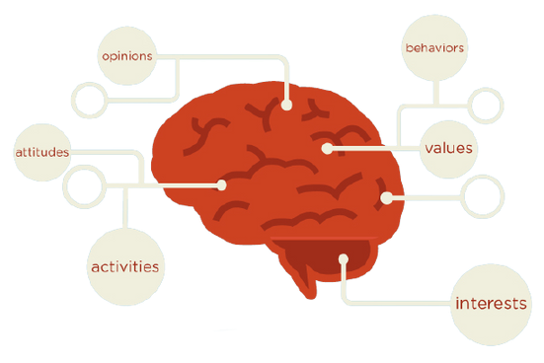
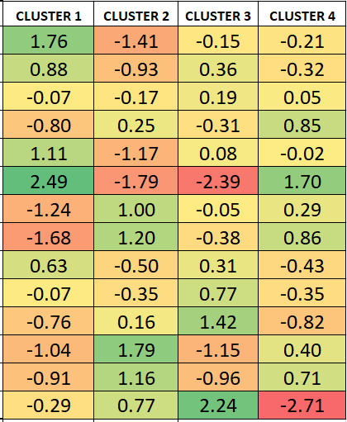
Psychographic Statements
I generally plan my expenses and never spend more than my budget I often take opinions or check reviews before buying
I often experiment with new brands rather than just sticking to old ones I like to spend my weekends with friends than staying at home
My favorite subjects in school were Mathematics & Science rather than Literature I make it a point to do some physical exercises almost everyday
When I go out for shopping, I end up buying more items just by impulse I am active on almost all Social media
I like light, sober colors to bright, exciting colors when it comes to clothing
I prefer watching videos/shows online rather than watching them in the television I prefer ordering in from online apps than dining out
I follow Brands, celebrities, influencers on social media I always try to keep up with new fashion trends
I prefer reading or listening to music rather than exercising or playing a sport

Slide 5
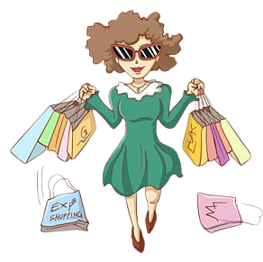


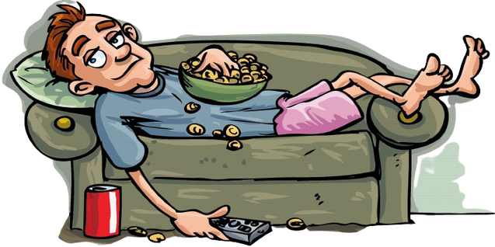
Cluster Characteristics
Cluster 1
ORTHODOX
Cluster 2
MODISH
Cluster 3
Indolent
Cluster 4
INTROVERTED
Budget conscious
A planned shopper Logical
Energetic and health conscious Prefers physical world
Impulse buyer Extravagant
Prefers digital world
Fashionista and celebs driven Outgoing person
Well versed Sophisticated
Lazy
Calm and composed Homely
Homebuddy
Health conscious
Digitally Active
Artistic

Slide 6
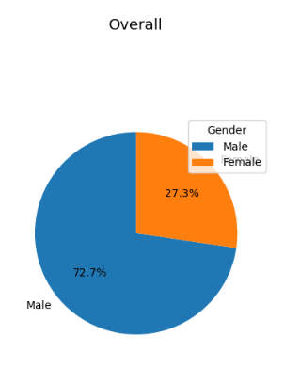
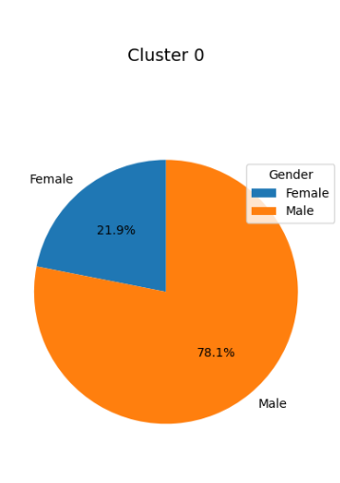
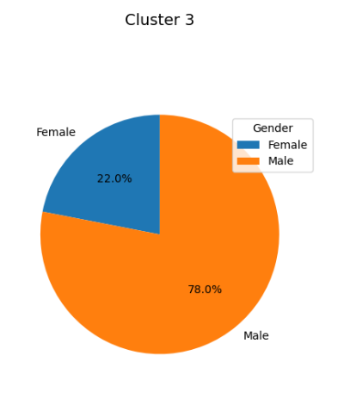
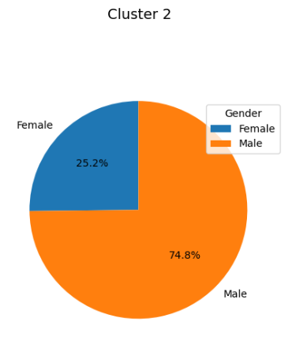
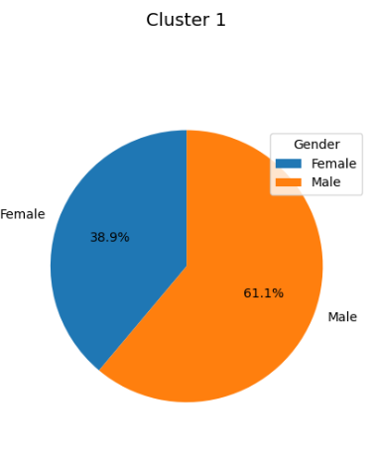
Gender distribution
A male dominant data set.
Overall
Cluster 1 female dominant.
Male 70%
Cluster 1 characteristics justifies higher percentage of female in that cluster.
Cluster 2 male dominant.
Cluster 2 characteristics justifies higher percentage of male in that cluster.

Slide 7
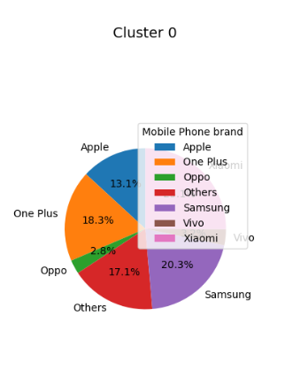
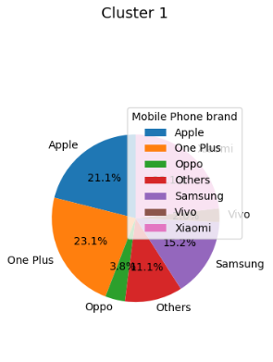
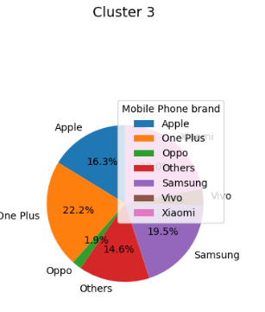
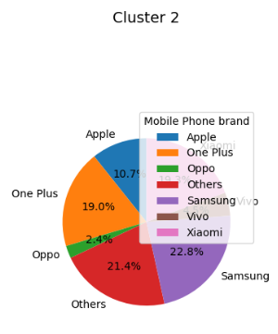
Mobile Phone user
Cluster 0 and Cluster 2 has over-spenders - higher percentage of Samsung.
Cluster 1 and Cluster 4 has over-spenders - higher percentage of One Plus
Oppo being the lowest in all the cluster2.

Slide 8
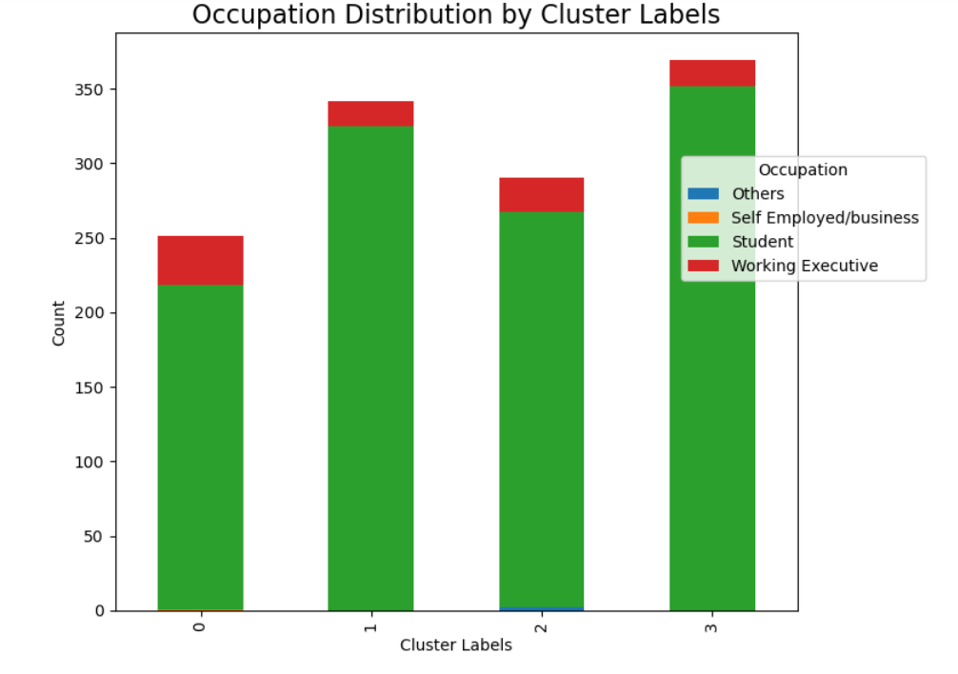
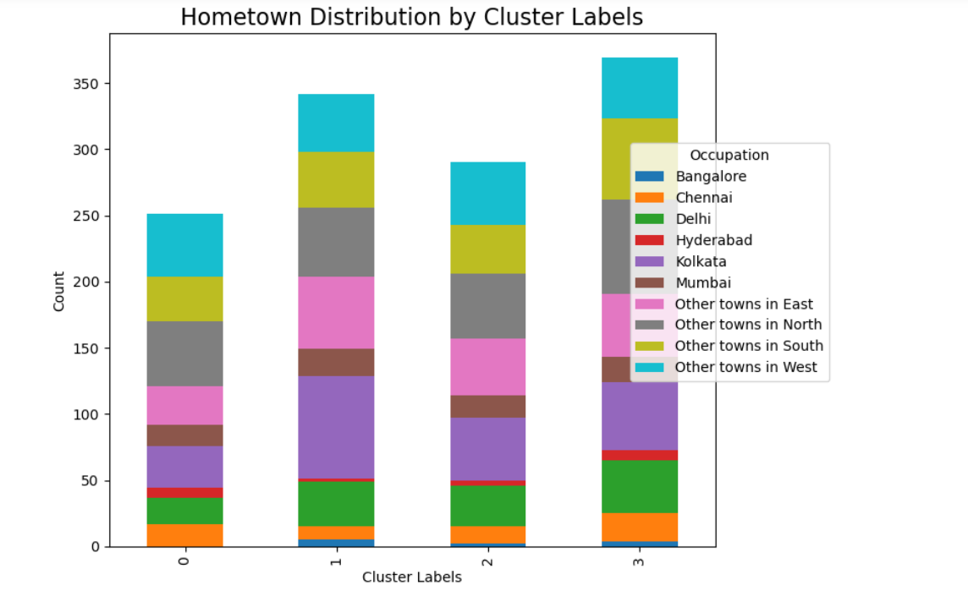
OCCUPATION & HOMETOWN

Slide 9
Identifying cluster membership
MODISH
ORTHODOX
Tanmoy Chandra
Dipam Sarkar
Angshuman Pandey
70%
85%
80%
Impulse buyer
Extravagant
Prefers digital world
Fashionista and celebs driven
Outgoing person
Impulse buyer
Extravagant
Prefers digital world
Fashionista and celebs driven
Outgoing person
Budget conscious
A planned shopper
Logical
Health conscious
Prefers physical world
Similar
Quiet Similar
Dissimilar

Slide 10



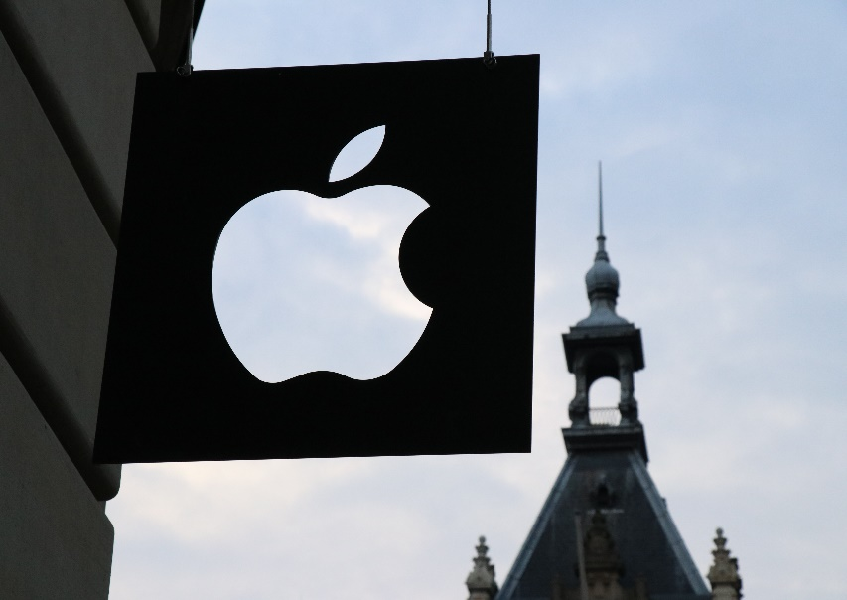


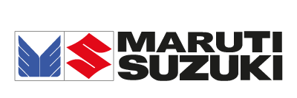

Brand Recommendations
MODISH
ORTHODOX
INDOLENT
INTROVERT

